Slide 1
Welcome to Marketing Operations Open Office Hours – August Session

Slide 2
Agenda
Welcome
Commercialization website updates
Website forms - submitting content to the web team
Q&A

Slide 3

Marketing Operations Open Office Hours
Get your questions answered by the marketing operations team. Open Office Hours are held monthly with the following agenda:
Learn about a tip or best practice
Ask a question – Pre-submit your questions here or ask during the office hours
Learn how to leverage IQVIA’s marketing systems and processes most effectively
Action: Sign up here, if you need to be added to the outlook invite
Reminder: Save your questions for the end or enter in the chat. We will address as many as we can!

Slide 4
Commercialization Web Update 1H25
CS GBU Marketing
Marketing Operations Open Office Hours August 6, 2025

Slide 5
Agenda
Commercialization web refresh
01 | Goal & objectives
02 | Project scope
03 | Process
04 | Key learnings
05 | What’s next

Slide 6
Commercialization web refresh
Goal
Restructure Commercialization web architecture and refresh content to help the market understand IQVIA’s ability to address a broad range of customer needs and use cases, help users find relevant content more efficiently and enhance engagement.
Objectives
Create a more effective and user-friendly web experience that supports our commercialization goals.
Implementation of new commercialization web architecture
Increase in organic pageviews
Increase engaged sessions and time on page
Multi-Page user path

Slide 7
Planning & phased implementation
Phase I - Site Mapping and Content Review
Create a site map of existing pages
Analyze key metrics
Content audit
Agency recommendations
Work with each marketer to build / update their pages
Work with web development team to convert PPT wireframes and mockups into functional webpages.
Phase II – Content and Collateral Refresh
Phase III - Build
Notes:
Phase 1 → Brandon helped pull “last update date” (although not always 100% accurate)

Slide 8
Proposed site map workshopped in Octopus
Phase I
Notes:
Talk through the color coding

Slide 9
Web refresh timeline
Phase II
15 January
March
4 April
11 April
5 May
Meet with marketers to review plan and what is required of them
Marketers to work on updating the content, identifying collateral and art
Content is due from marketers
Katherine reviews content
Marketer refinement & final copy, art and collateral ready
June 9 – June 20th BLACKOUT
(no solution page updates)
7 May
8 - 21 May
21 – 30 May
4 June
June
JUNE 30, 2025
GO LIVE
Alexis submits ticket to offshore team
Offshore team applies updates
Marketers initial review of staging link
Marketers review, edit, and approve staging link
Backend organization

Slide 10
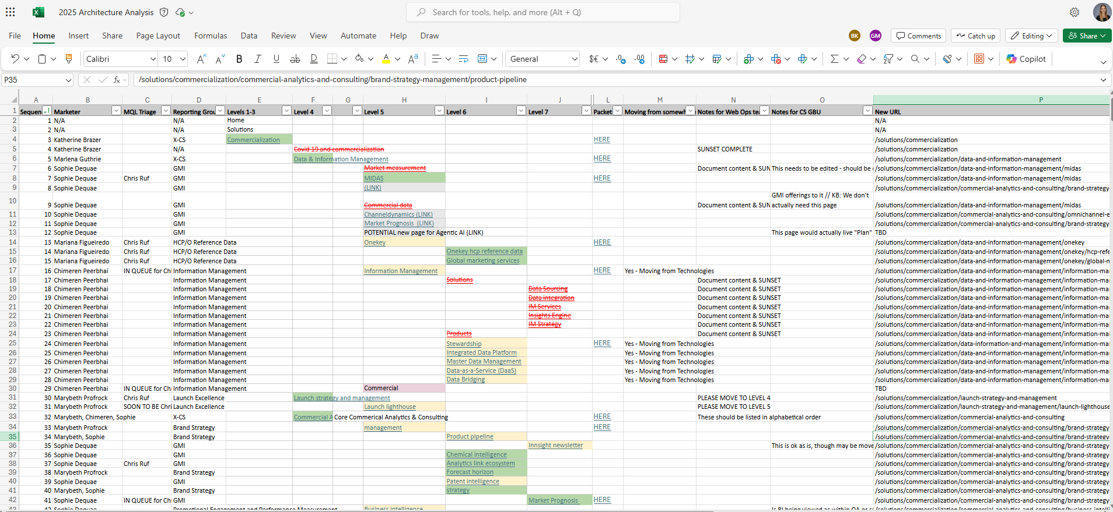
Transferred site map from Octopus to Excel
Phase III

Slide 11
The packet

Slide 12
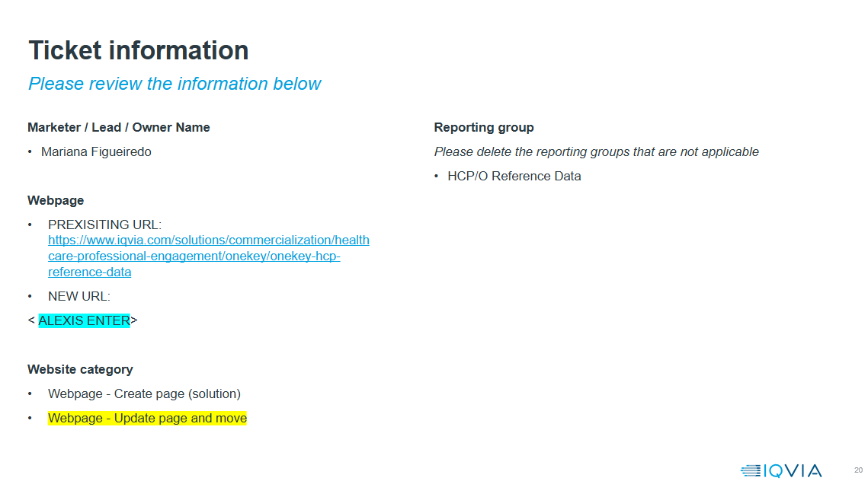
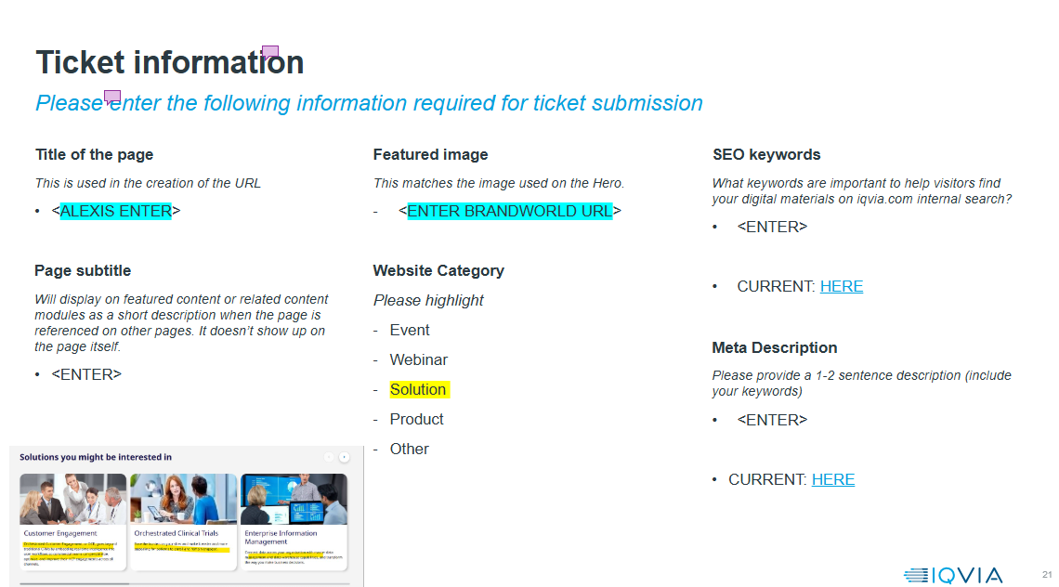
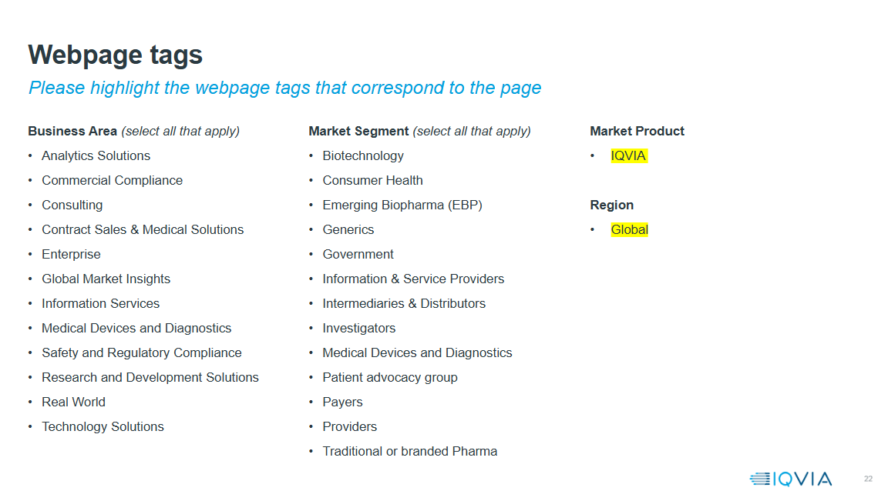
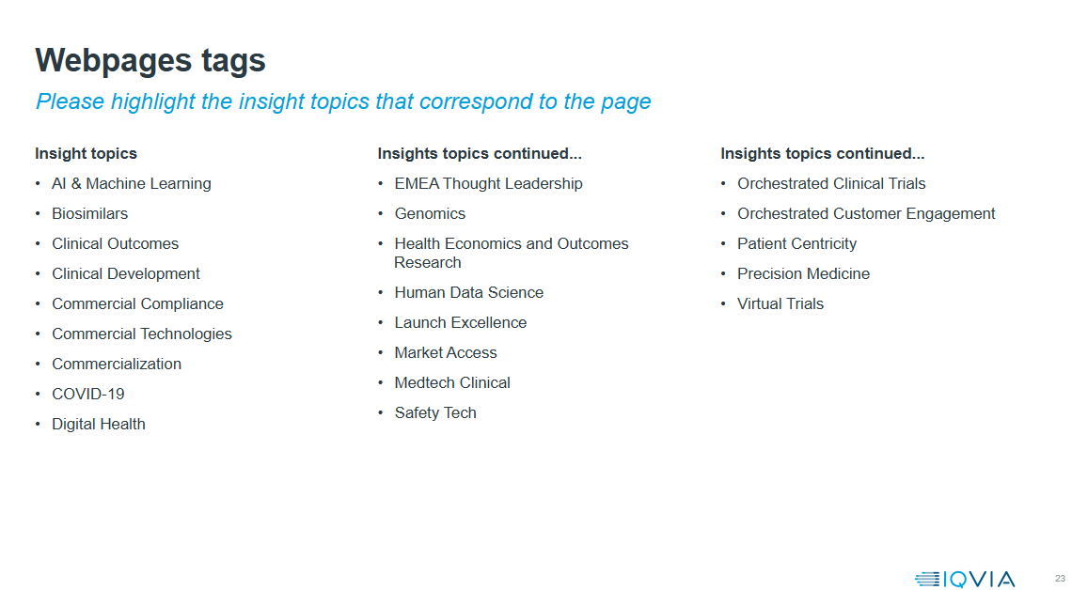
The packet: What is included
Ticket information, proposed wireframe and SEO, UX & content recommendations
Tips to consider
Headlines and Subheads:
Ensure headlines and subheads are clear, compelling, and accurately reflect the content. Use concise and action-oriented language. Incorporate relevant keywords naturally.
Body Copy:
Improve readability by using short paragraphs, bullet points, and lists. Ensure content is up-to-date, relevant, and valuable to the target audience. Remove jargon and overly complex language.
Structure:
Evaluate the proposed site architecture
Identify key sections and pages

Slide 13
Consistent jump bar heading and page structure across CS site
Pillar Pages (Data, A&C, CES)
Exact Tab Titles Required (Don’t Change Wording) >>
Overview
Offerings / Products / Services
Benefits
Featured Customer Story
Latest Thinking
Explore Related
Content Requirements
Set Up Customer Challenge(s)
Offerings = Blend of Products and Services
Products = Just Products
Services = Just Services
Top 3-5 Business Benefits / Differentiators of Category, Overall
Feature 1 Per Area (Rotate 2-4X / Year Going Forward)
Links to Content
3 Links (1 to Commercialization and Other 2 Umbrella Pages)
Child Pages of Pillar Pages
Exact Tab Titles Required (Don’t Change Wording) >>
Overview
Featured content
Offerings / Products / Services
Benefits
Latest Thinking
Explore Related
Content Requirements
Set Up Customer Challenge(s)
Options:
Video Module
50/50 Module with Hero Asset, Upcoming Webinar, Upcoming Event, Recent Analyst Report
Interactive case study module
Featured story module
Card module
Tab Module required to match offering menus on pillar pages
Offerings = Blend of Products and Services
Products = Just Products
Services = Just Services
Includes any “Why IQVIA” info, if not already covered in Overview
Options:
Stats Module
Interactive case study module
Quote module
Choices: Latest Thinking Module with Content Links OR Content Ticker with Content Links
2 or More Links (1 to Parent Pink Page, 1 to Commercialization Page – do not link to any child pages since those will be covered in “Offerings” but can consider linking to other relevant non-child pages in addition to 2 required pages specified above)
Page Header
Mid Level Hero Module with Image (Do Not Use Video) and Blue Background

Slide 14
What’s next

Slide 15
Post-go-live next steps
Internal testing, data collection, and testing plan
Eastern Standard
SEO audit
Data collection (June 30 – August 15, 2025)
UX insights & further recommendations
Commercial Solutions GBU marketing
Update additional yellow pages
Continue data collection
Implement testing on priority pages

Slide 16
Questions?

Slide 17
Website forms

Slide 18
Website content
Content categories and support forms
You can add various types of content to the website. In our system, content is categorized into these buckets:
Web pages - solution pages for products and services, news, events/webinars and blogs
Asset pages link to gated and ungated PDFs – brochures, case studies, fact sheets, infographics, insight briefs, podcasts, publications, videos, audios, white papers
Each form supports a different category of content
Smartsheet form is used for web pages
Via form is used for asset pages
This form allows the PDF asset to be posted to Brand World, the website, and Sales Spot, which is why this is separate from Smartsheet
Plans are in place to transition everything to the Smartsheet
Each form asks you to identify the content category ( “type”) so that you can supply the right content for the team to set up the page properly
While most of the fields are the same, there may be differences between the categories such as a blog versus a webinar.

Slide 19
Tips to make the process more efficient​
Images must be brand approved
If you need a custom graphic, work with Creative Services before submitting your request – this will speed up the process of getting your request completed
Don’t embed images in Word documents or PDFs. Send Brand World URLs and attach custom images to the ticket.
Do not send PPT images or charts – they must be converted to graphics before we can use them.
Videos must follow Brand Guidelines and be uploaded to Brightcove before we can use them on the website
Podcasts must also follow Brand Guidelines.
Claims (proof points) must be in the Claims database before we can set them up on the website
Include the web stat # in your request so that we can find the correct claim.
When supplying the team with documents, send files like Word or PowerPoint that we can cut and paste from — no scanned PDFs.
Keep the formatting simple by using standard options like bold, italics, underline, and hyperlinks.
Avoid the use of tables in your Word documents unless it’s for tabular data.
Updates to text - if you have a lot of changes to a single page, go ahead and send a replacement document for everything.
If you have minor changes, please send those rather than a replacement document.
If you are updating a solution page and you also need to either add or update an asset, you’ll have to submit a separate ticket for the asset using the VIA form.

Slide 20
VIA Form – how to find the content type
When you open the form, you’ll pick Add or Replace an Asset from the What do you need to do drop down.
Under Content type - you need to choose one of the Sales & Marketing options and then choose the type of asset you want to add. The most popular options for the website are listed to the right.
If you do not pick an asset type that appears on the website, the form request will not be sent to the website activation team for posting.
If you need help, please reach out to Edie Eichert
Sales & Marketing Materials – Thought Leadership Materials
Article
Insight Briefs
Publications
White Papers
Sales & Marketing Materials – Prospecting Materials
Brochures
Fact Sheets
Infographics
Sales & Marketing Materials – Sales Engagement Materials
Case studies

Slide 21
Thank You

